Slide 1
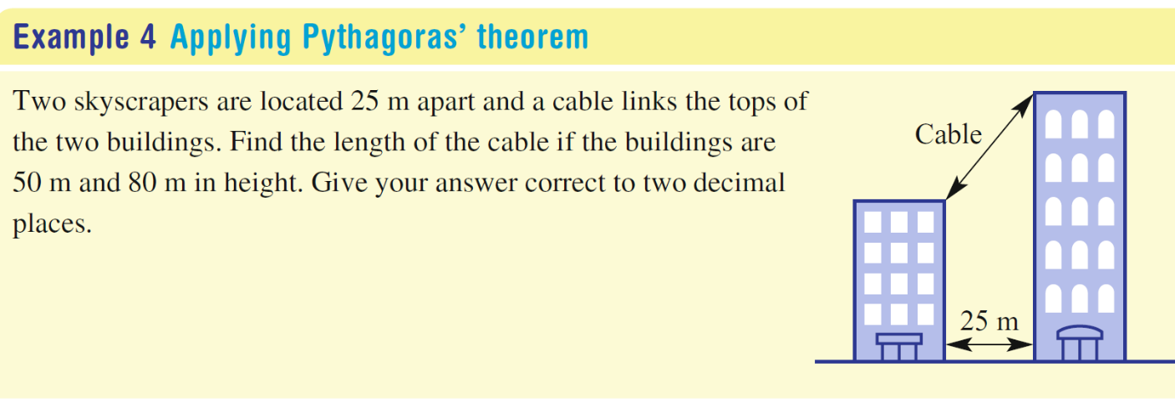
Topic: Pythagoras
EQ – How can we solve problems involving right-angled triangles?
What are the steps?
Draw a diagram to help identify the right-angled triangles that may help solve the problem.
Label the sides with their lengths. Use a pronumeral if the length is not unknown.
Use Pythagoras’ Theorem to work out the unknown.
Solve the problem by making any further calculations and answering in words.

Slide 2
